Slide 1
University Admission and Job Application System
Presented by : Neha Shakoor
SAP ID:42738
Instructor : Sir Noor Ullah Khan

Slide 2
Two-dimensional code
This project is about management system of university admission and job applications.
This program is two-dimensional. One code leads towards the university admission and second one leads to the job application.
I made a program which tells user if they’re eligible for admission / job or not.

Slide 3
Pros of the program
It reduces our time to search for universities and jobs online and than apply separately on different websites and than wait for challan form to generate and mails for the Roll.no slip.
This program saves your time and generates you the challan for fee of student.
And roll.no slip for the job test or interview.
In addition to the Roll.no slip, You can select your own date on which you want took test.
It saves our money. Now a days everyone wants a modern solution and less time taking solution.

Slide 4
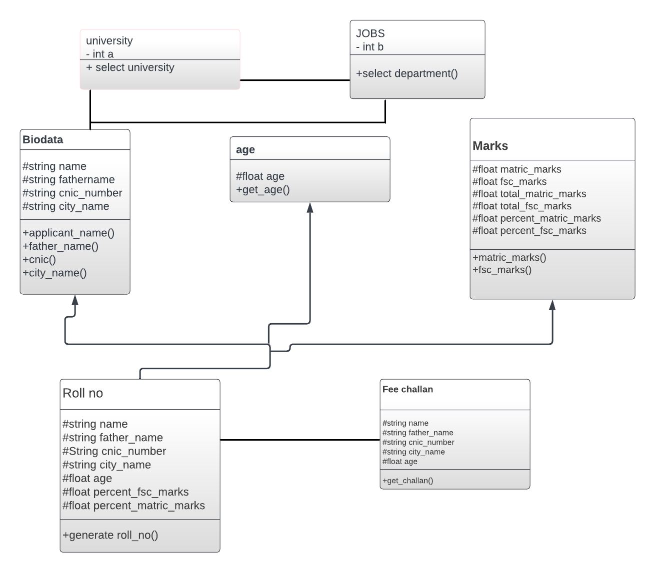
Here’s the UML diagram to check the path of our code

